Slide 1

Final Project: Agile Presentation
By: Dylan Coulter
CS 250

Slide 2

Scrum-agile Team
Product Owner
Scrum Master
Development Team
Figure 1: Three team members sitting around a table working as a group. Adapted from “ Software Development Team Structure: Things to Consider. By Irina Linnik. 2020 Softteco.com

Slide 3
Product Owner
The product owner is responsible for understanding the business needs of the product, this consists of customer expectations, and market trends. The product owner makes sure the Scrum team is aligned with the goals of the overall product that the entire team is contributing to. The product owner has to understand how the Scrum team fits into the bigger picture goals and they continuously stay in touch with product managers and stakeholders outside the team.
Orders work by priority and manages the product backlog
Makes sure to set the vision for the entire team
Constant communication with external stakeholders so they can translate their needs to the rest of the team
Through communication and evaluation ensures team is focused on achieving product needs
(2022, June 15). Scrum Team Roles And Responsibilities: Scrum Master And Product Owner.
https://www.softwaretestinghelp.com/scrum-roles-responsibilities/
Coursera (2022, May 26). The 3 Scrum Roles and Responsibilities, Explained.
https://www.coursera.org/articles/scrum-roles-and-responsibilities

Slide 4
Scrum Master
The Scrum Master’s role is to ensure the team is following scrum values and is operating as effectively as possible. They focus on keeping the team on track, planning and leading meetings, and assisting the team in overcoming any obstacles they may face. The Scrum master is both a leader and a behind-the-scenes supporter of the team because of this they can be described as a ”servant leader” of the Scrum team.
Facilitate daily Scrum meetings
Lead sprint planning meetings
Utilizes “retrospective” reviews to understand what went well and what can be improved in the following sprint
Utilizes individual meetings and other forms of communication to keep a pulse on team members
Manages obstacles that the team may have by communicating with stakeholders outside the team
(2022, June 15). Scrum Team Roles And Responsibilities: Scrum Master And Product Owner.
https://www.softwaretestinghelp.com/scrum-roles-responsibilities/
Coursera (2022, May 26). The 3 Scrum Roles and Responsibilities, Explained.
https://www.coursera.org/articles/scrum-roles-and-responsibilities

Slide 5
Development Team
The development team does the hands-on work of completing tasks in a Scrum sprint. Some development team members may be computer engineers, designers, writers, data analysis, and any other role to help the team reach the sprint goal.
Assist in goal setting and sprint planning
Utilizes expertise to design, program, or improve products
Utilizes data to understand the best practices for development
Works on quality assurance such as testing products and prototypes
(2022, June 15). Scrum Team Roles And Responsibilities: Scrum Master And Product Owner.
https://www.softwaretestinghelp.com/scrum-roles-responsibilities/
Coursera (2022, May 26). The 3 Scrum Roles and Responsibilities, Explained.
https://www.coursera.org/articles/scrum-roles-and-responsibilities

Slide 6

SDLC (Software Development Life Cycle) And The Agile Approach
Figure 2: Six team members working as a group. Adapted from “Functional Sizing in Agile Projects. By Agus Wintarta. 2020 Mitrais.com

Slide 7
SDLC (Software Development Life Cycle)
Planning – Project leaders evaluate the terms of the project
Define Requirements – Determine requirements and what the application is supposed to do
Design and Prototyping – Model the way the software application will work
Software Development – Write the program
Testing – Test must be done before making product available to the users
Deployment – The product is made available to users in this phase
Operations and Maintenance – Maintain the product after release for example, updates and bug fixes
Jevtic, G. (2019, May 15). What is SDLC? Phases of Software Development, Models, & Best Practices https://phoenixnap.com/blog/software-development-life-cycle

Slide 8
The Agile Approach
Requirements – Product owner and Stakeholder create a development plan for the project by conducting an overall assessment
Design – Software development team learns about the requirements and starts planning and developing a prototype
Development and Coding – Utilizing Sprints the team will start to develop the product improving the product after each sprint. Each cycle includes testing in the case bugs are found they can be handle immediately
Integration and testing – Product becomes available to the consumers allowing the team to run more test on a larger scale. Feedback is also collected during this phase.
Implementation and Deployment – Software is fully deployed during this phase. Now the team focuses on maintenance, updates, and ongoing support of the product.
Review – Development team presents meeting the requirements to the owner and the results achieved. At this point the Agile development team phases start over. This is either with a new iteration or or moving to the next stage and scaling agile.
All of us at Monday.com (2022, February 9). What is Agile SDLC and How Should You Use It In 2022. https://monday.com/blog/rnd/agile-sdlc/

Slide 9
The Agile Approach
The AGILE model was created by developers to ensure they put the customers needs first. This method has a strong focus on input and user experience. This makes the software extremely responsive to customer feedback. Agile focuses on quick software cycles to allow to a quicker response to changing markets. Agile requires a strong team with great communication.
Individuals and interactions over Process and tools
Working software over Comprehensive documentation
Customer collaboration over Contract negotiation
Responding to change over Following a plan
All of us at Monday.com (2022, February 9). What is Agile SDLC and How Should You Use It In 2022. https://monday.com/blog/rnd/agile-sdlc/
Bestaieva, D. (2022, May 25). What is Agile SDLC: The Guide On Major Software Development Methodology in 2022 https://www.cleveroad.com/blog/agile-sdlc/

Slide 10
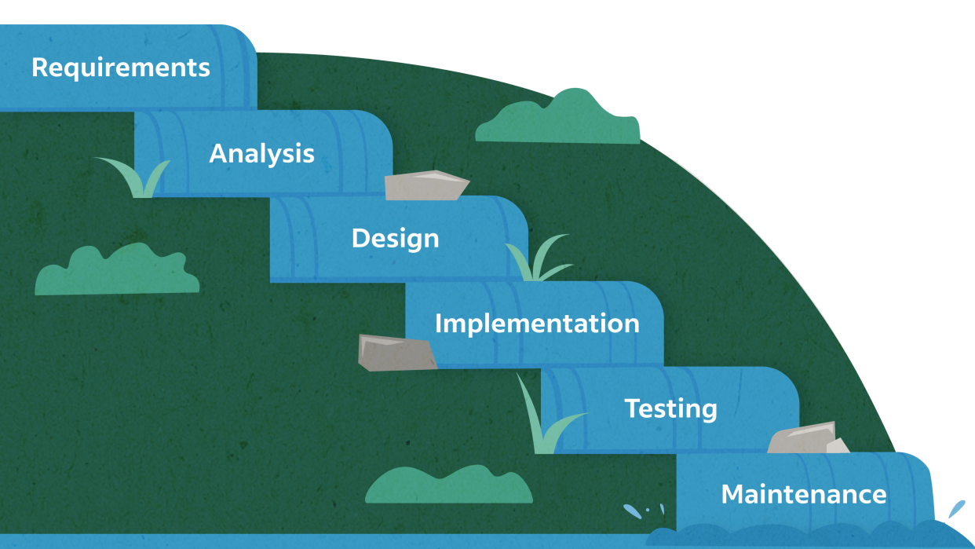
The Waterfall Approach
Figure 3: Animation of the waterfall concept containing the different stages.“ A Complete Guide to the Waterfall Methodology. By Indeed Editor Team. 2020 Indeed.com

Slide 11
The Waterfall Development Approach
Requirement Analysis
Design
Implementation
Verification and Testing
Deployment and Maintenance
All of us at Monday.com (2022, February 9). What is Agile SDLC and How Should You Use It In 2022. https://monday.com/blog/rnd/agile-sdlc/
Adobe Express Cloud: Waterfall Methodology
https://www.workfront.com/project-management/methodologies/waterfall

Slide 12
The Waterfall Approach
When considering the Waterfall SDLC model as each phase completes the project spills over into the next step. The Waterfall process is a sequential development process that flows like a waterfall during all phases of a project. Each phase must complete wrap up before the next phase is started. Documentation is key as different teams will be working on different phases of the project. There is also limited engagement with stakeholders after the initial agreement.
Carefully planned first version
Limited transparency
Top-down responsibility
Initial research and planning
Different teams in different stages
Focused on delivering full product
All of us at Monday.com (2022, February 9). What is Agile SDLC and How Should You Use It In 2022. https://monday.com/blog/rnd/agile-sdlc/
Adobe Express Cloud: Waterfall Methodology
https://www.workfront.com/project-management/methodologies/waterfall

Slide 13
Utilizing the Waterfall Approach with the SNHU Travel Project
If the SNHU Travel project decided to take the Waterfall approach certain aspects of the project would have been handle differently than what we saw with the Agile approach the team utilized during the project.
The entire direction of the project would have been decided before development
Limited contact between team and Stakeholders
Each phase of the project must be complete before moving on to next phase
Documentation is key as one team may start something and not be the team to finish it
During the development of the SNHU Travel Project the product owner met with stakeholders multiple times for feedback and input. This caused for the team to quickly have to change directions to fulfill their requirements. If we were working with the Waterfall approach then this requirement would have never reached the team resulting in the stakeholders not being as satisfied.
Adobe Express Cloud: Waterfall Methodology
https://www.workfront.com/project-management/methodologies/waterfall

Slide 14
Choosing between Agile and Waterfall
When making the choice to take the Agile approach we would need to consider
Will the customer expect to stay In touch with the project and provide feedback throughout different stages? Collaborating and communicate are key factors in the Agile approach.
How fast do we want to deploy the product? The Agile approach is focused on quick iterations and fast turn around times allowing for quicker development times.
How do you want the team to respond to change? Teams working with the Agile approach effectively react to change due to the nature of the process.
When making the choice to take the Waterfall approach we would need to consider
How important is it to have a concrete plan to follow that does not change through the project? With Waterfall the project direction is agreed upon earlier and never strayed from.
How important is it that the entire cost of the project be estimated before the start? When considering Waterfall due to the early agreement on direction the project is easier to estimate total cost.
How important is it to meet a time deadline for completion? The Waterfall approach has set plans and deadlines
All of us at Monday.com (2022, February 9). What is Agile SDLC and How Should You Use It In 2022. https://monday.com/blog/rnd/agile-sdlc/
Bestaieva, D. (2022, May 25). What is Agile SDLC: The Guide On Major Software Development Methodology in 2022 https://www.cleveroad.com/blog/agile-sdlc/
Jevtic, G. (2019, May 15). What is SDLC? Phases of Software Development, Models, & Best Practices https://phoenixnap.com/blog/software-development-life-cycle
Adobe Express Cloud: Waterfall Methodology
https://www.workfront.com/project-management/methodologies/waterfall

Slide 15
References (TEXT)
Agile Software Development Life Cycle (SDLC)
https://www.javatpoint.com/agile-sdlc
All of us at Monday.com (2022, February 9). What is Agile SDLC and How Should You Use It In 2022.
https://monday.com/blog/rnd/agile-sdlc/
Bestaieva, D. (2022, May 25). What is Agile SDLC: The Guide On Major Software Development Methodology in 2022
https://www.cleveroad.com/blog/agile-sdlc/
Jevtic, G. (2019, May 15). What is SDLC? Phases of Software Development, Models, & Best Practices
https://phoenixnap.com/blog/software-development-life-cycle
Adobe Express Cloud: Waterfall Methodology
https://www.workfront.com/project-management/methodologies/waterfall
(2022, June 15). Scrum Team Roles And Responsibilities: Scrum Master And Product Owner.
https://www.softwaretestinghelp.com/scrum-roles-responsibilities/
Coursera (2022, May 26). The 3 Scrum Roles and Responsibilities, Explained.
https://www.coursera.org/articles/scrum-roles-and-responsibilities

Slide 16
References (IMAGES)
Figure 1: Three team members sitting around a table working as a group. Adapted from “ Software Development Team Structure: Things to Consider. By Irina Linnik. 2020 Softteco.com
Link: https://softteco.com/blog/software-development-team-structure
Figure 2: Six team members working as a group. Adapted from “Functional Sizing in Agile Projects. By Agus Wintarta. 2020 Mitrais.com
Link: https://www.mitrais.com/news-updates/functional-sizing-in-agile-projects/
Figure 3: Animation of the waterfall concept containing the different stages.“ A Complete Guide to the Waterfall Methodology. By Indeed Editor Team. 2020 Indeed.com
Link: https://www.indeed.com/career-advice/career-development/waterfall-methodology

